Slide 1
Chapter 4
Regression and Prediction Part 2

Slide 2
Agenda
Simple Linear Regression
Multiple Linear Regression
Prediction Using Regression
Factor Variables in Regression
Interpreting the Regression Equation
Regression Diagnostics
Polynomial and Spline Regression

Slide 3
Factor Variables in Regression

Slide 4
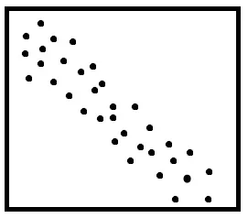
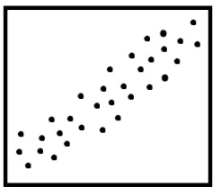
Regression Equation
House Size
Age
Sales Price
Sales Price
Sales Price= b0 + b1*House Size –b2*Age

Slide 5
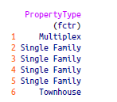
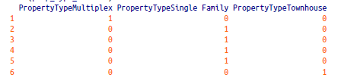
Factor Variables in Regression
Factor variables, also termed categorical variables, take on a limited number of discrete values. For example, a loan purpose can be “debt consolidation,” “wedding,” “car,” and so on. The binary (yes/no) variable, also called an indicator variable, is a special case of a factor variable. Regression requires numerical inputs, so factor variables need to be recoded to use in the model. The most common approach is to convert a variable into a set of binary dummy variables.
Dummy Variable is a variable that takes values of 0 and 1, where the values indicate the presence or absence of something
Why dropping the first one?
In the regression setting, a factor variable with P distinct levels is usually represented by a matrix with only P – 1 columns. This is because a regression model typically includes an intercept term. With an intercept, once you have defined the values for P – 1 binaries, the value for the Pth is known and could be considered redundant. Adding the Pth column will cause a multicollinearity error
1-pd.get_dummies(house['PropertyType']).head()
2-pd.get_dummies(house['PropertyType'], drop_first=True).head()

Slide 6


Factor Variables with Many Levels
Some factor variables can produce a huge number of binary dummies—zip codes are a factor variable, and there are 43,000 zip codes in the US. In such cases, it is useful toexplore the data, and the relationships between predictor variables and the outcome, to determine whether useful information is contained in the categories. If so, youmust further decide whether it is useful to retain all factors, or whether the levelsshould be consolidated.
Drop it?
EDA ?
It could be a good idea, but what if it’s too important for your model like the Zip code which proxy for the effect of location on the
value of a house.
Not Again
For some of your categorical features, ordering may actually make sense, like "small,medium,big". In such case, you can just use numerical encoding without increasing number of features
A recommended approach is to group the zip codes according to another numerical variable, such as sale price.
https://medium.com/data-design/visiting-categorical-features-and-encoding-in-decision-trees-53400fa65931

Slide 7
Ordered Factor Variables
Some factor variables reflect levels of a factor; these are termed ordered factor variables or ordered categorical variables. For example, the days, or months, we know that Tuesday is always after Monday and October is always before November.
January | 1
February | 2
March | 3
April | 4
May | 5
June | 6
July | 7
August | 8
September | 9
October | 10
November | 11
December | 12
Monday | 1
Tuesday | 2
Wednesday | 3
Thursday | 4
Friday | 5
Saturday | 6
Sunday | 7
data[‘Grade'] = data[‘Grade'].apply(lambda x: ['Po’, Med’, Gd’,'Ex'].index(x))
Po | 1
Med | 2
Gd | 3
Ex | 4

Slide 8

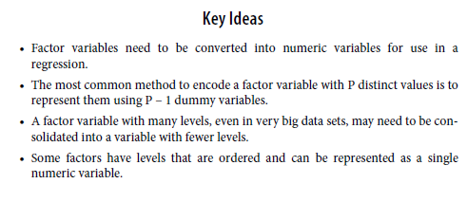

Slide 9
Interpreting the Regression Equation

Slide 10

Interpreting the Regression Equation
In data science, the most important use of regression is to predict some dependent (outcome) variable. In some cases, however, gaining insight from the equation itself to understand the nature of the relationship between the predictors and the outcome can be of value. This section provides guidance on examining the regression equation and interpreting it.
Positive or Negative correlation ?
Number of bedrooms
House Price

Slide 11

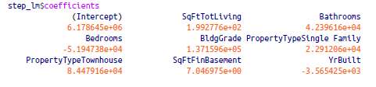
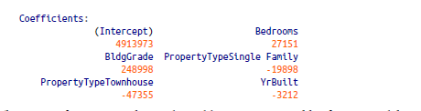
Correlated Predictors
The coefficient for Bedrooms is negative! This implies that adding a bedroom to a house will reduce its value. How can this be? This is because the predictor variables are correlated: larger houses tend to have more bedrooms, and it is the size that drives house value, not the number of bedrooms. Consider two homes of the exact same size: it is reasonable to expect that a home with more but smaller bedrooms would be considered less desirable.
Having correlated predictors can make it difficult to interpret the sign and value of
regression coefficients (and can inflate the standard error of the estimates).
Removing house size Feature

Slide 12
Multicollinearity
An extreme case of correlated variables produces multicollinearity—a condition in which there is redundance among the predictor variables. Perfect multicollinearity occurs when one predictor variable can be expressed as a linear combination of others.
Multicollinearity occurs when:
• A variable is included multiple times by error.
• P dummies, instead of P – 1 dummies, are created from a factor variable • Two variables are nearly perfectly correlated with one another. Multicollinearity in regression must be addressed—variables should be removed until the multicollinearity is gone. A regression does not have a well-defined solution in the presence of perfect multicollinearity. Many software packages, including R and Python, automatically handle certain types of multicollinearity. For example, if SqFtTotLiving is included twice in the regression of the house data, the results are the same as for the house_lm model. In the case of nonperfect multicollinearity, the software may obtain a solution, but the results may be unstable.

Slide 13



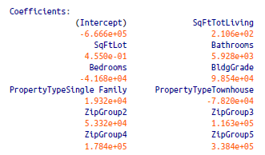
Confounding Variables
Why would i hot encode the postcode with over 43k unique values, i could simply drop the feature.
I have spent two days thinking about how to feed the postcode to my model, and what i did is grouped by the Sales price by postcode in an Ascending order and cluster them into five groups (group1 , group2 , group3 , group4 , group5), then i encoded them into dummy variables, and here’s how my model looks like
An important variable is not included in the regression equation.
Naive Interpretation of the equation coefficients can lead to invalid conclusions.

Slide 14
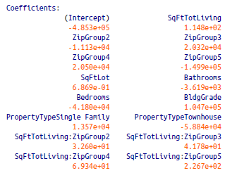
Interactions and Main Effects
Main Effects = Independent Variable = Explanatory Variable=predictor variable
An implicit assumption when only main effects are used in a model is that the relationship between a predictor variable and the response is independent of the other predictor variables. This is often not the case.
Example
Location in real estate is everything, and it is natural to presume that the relationship between, say, house size and the sale price depends on location. To materialize this, we’ll measure the if there’s any interaction the location and House Size using the following formula in Python:
model = smf.ols(formula='AdjSalePrice ~ SqFtTotLiving*ZipGroup + SqFtLot + ' +
'Bathrooms + Bedrooms + BldgGrade + PropertyType', data=house)
Location and house size appear to have a strong interaction. For a home in the lowest
ZipGroup, the slope is the same as the slope for the main effect SqFtTotLiving, which
is $118 per square foot (this is because R uses reference coding for factor variables;. For a home in the highest ZipGroup, the slope is the sum of the main effect plus SqFtTotLiving:ZipGroup5, or $115 + $227 = $342 per square foot. In other words, adding a square foot in the most expensive zip code group boosts the predicted sale price by a factor of almost three, compared to the average boost from adding a square foot.

Slide 15
Regression Diagnostics

Slide 16
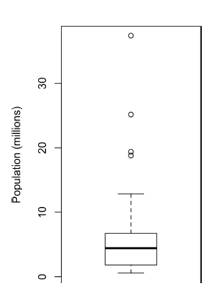
Regression Diagnostics
In explanatory modeling (i.e., in a research context), various steps, in addition to the
metrics mentioned previously, are taken to assess how well the model fits the data; most are based on analysis of the residuals. These steps do not directly address predictive accuracy, but they can provide useful insight in a predictive setting.
Outliers
There is no statistical theory that separates outliers from nonoutliers. Rather, there
are (arbitrary) rules of thumb for how distant from the bulk of the data an observation needs to be in order to be called an outlier. For example, with the boxplot, outliers are those data points that are too far above or below the box boundaries, where “too far” = “more than 1.5 times the interquartile range.” In regression, the standardized residual is the metric that is typically used to determine whether a record is classified as an outlier. Standardized residuals can be interpreted as “the number of standard errors away from the regression line.”

Slide 17
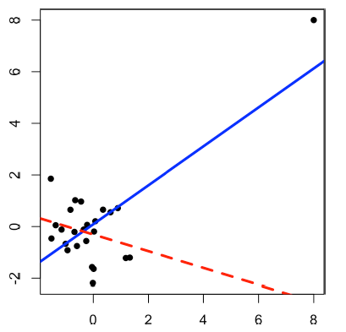
Influential Values
A value whose absence would significantly change the regression equation is termed an influential observation
What is this?
What’s the difference ?
hat-value= 2( P + 1) /n

Slide 18
Polynomial and Spline Regression

Slide 19
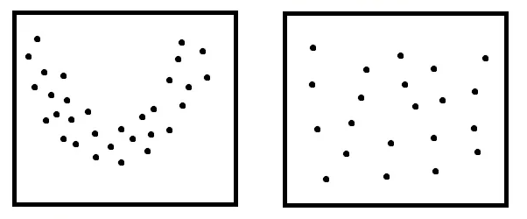
Polynomial and Spline Regression
In Real World, the relationship between two variables are not ALWAYS Linear
Sometimes they could be …

Slide 20
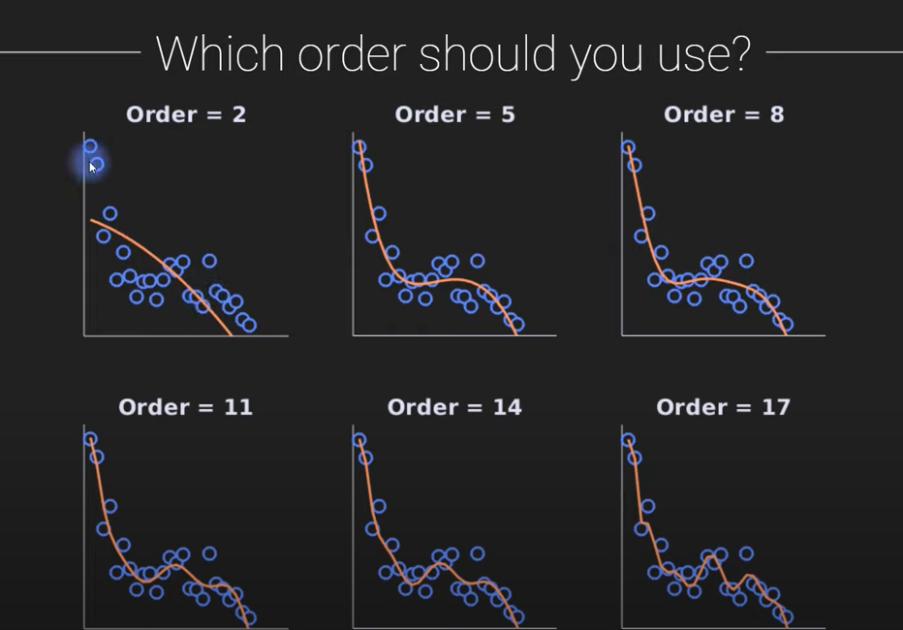
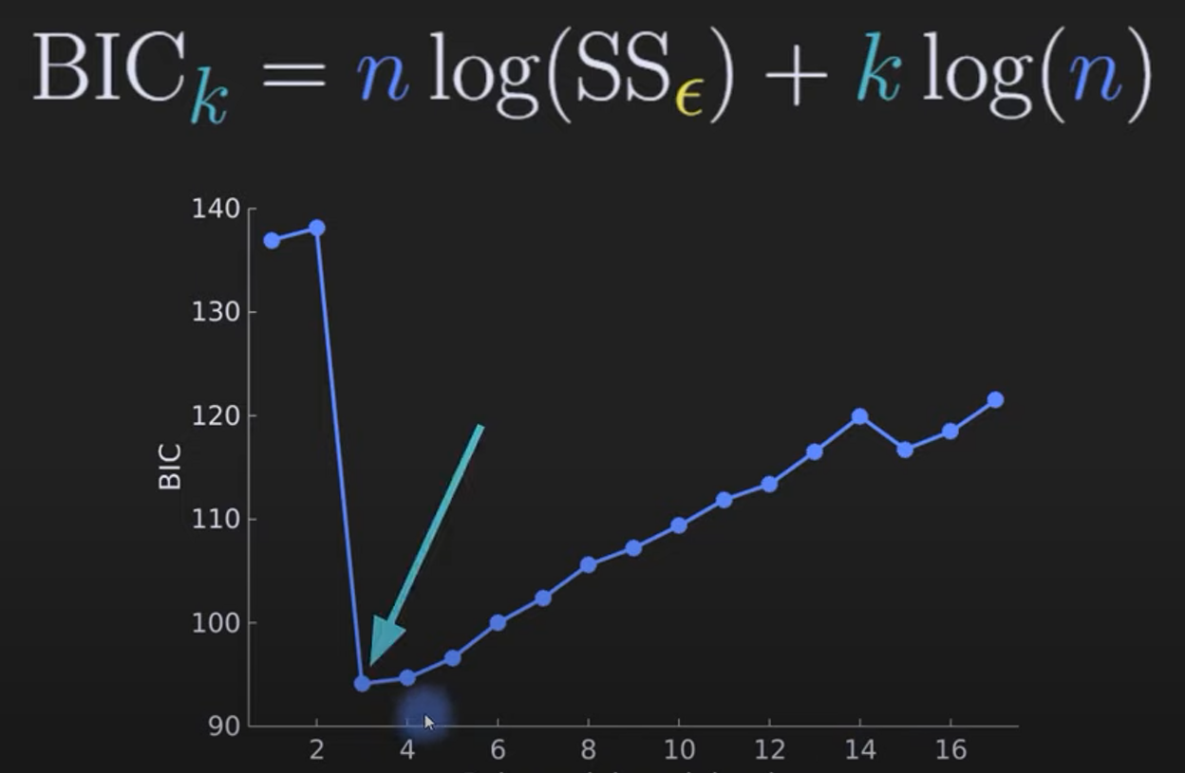
Which Degree to choose

Slide 21
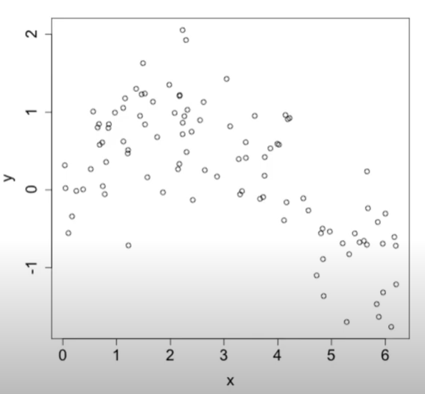
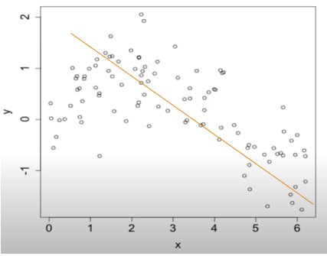
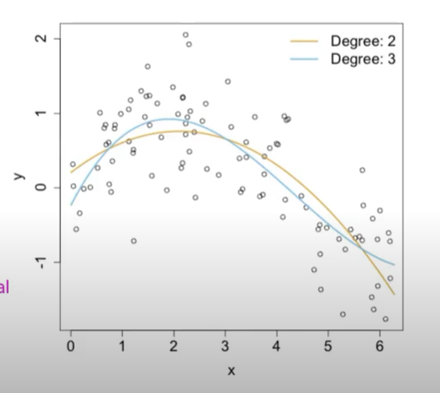

Is Polynomial enough
Polynomial Regression impose a global structure of the relationship, this means that if we choose the degree 3, we condamn the entire relation to cubic.
Is there a way to make Polynomial in pieces

Slide 22
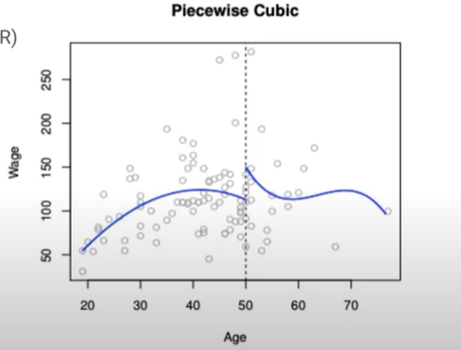
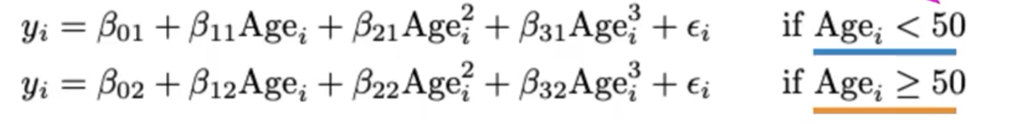
Spline Regression
Instead of fitting a plynomial globally over the entire range of x, fit multiple polynomial locally in different regions of x
Unnatural discontinuity
KNOT
Can be fixed with Constraints

Slide 23
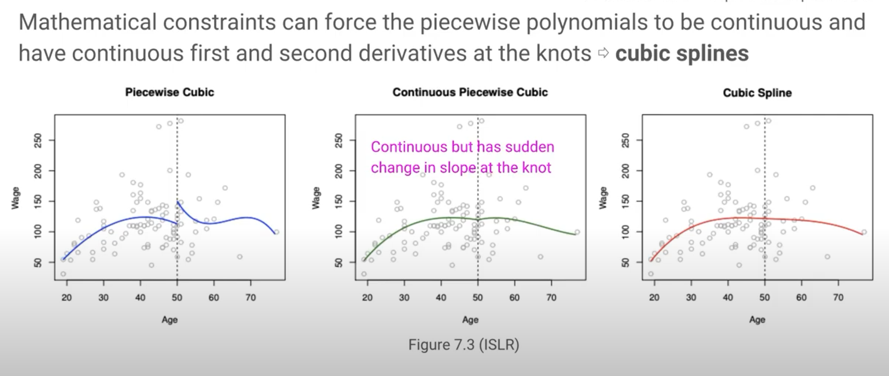
Spline Regression

